Slide 1
Concussion Conversation Presentation by ______

Slide 2
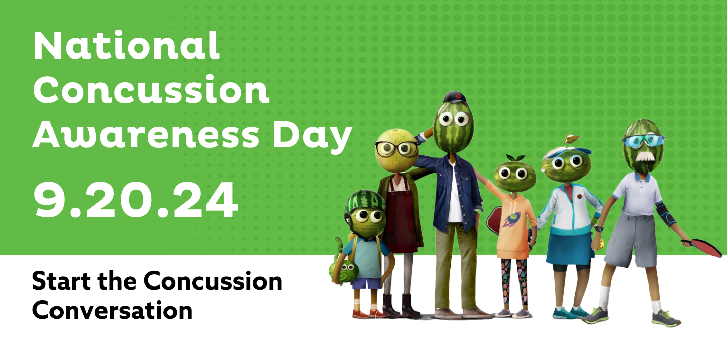
National Concussion Awareness Day is September 20!
Notes:
Add introductory comments about why and how you are starting the concussion conversation.

Slide 3
Why Concussion Education and Awareness is Important to Me
Use this space to customize your personal connection to concussion and why you work to educate and raise awareness
Add your photo on the right side
Notes:
Share your personal background and concussion story, if you are comfortable.
Why is National Concussion Awareness Day important to you?

Slide 4
Concussion Overview & Statistics

Slide 5
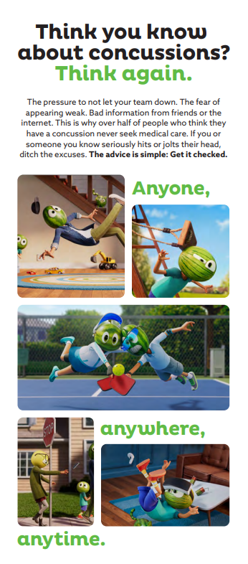
What is a concussion?
A concussion is an injury to the brain. The damage can change the way a person acts, thinks, and feels.
Concussions are the most common type of traumatic brain injury.
How do concussions occur?
They can occur when there’s a sudden impact from a fall, bump, hit or jolt that causes the brain to bounce around or twist inside the skull.
Falls are the #1 cause of concussions.
Concussions can happen to anyone, anytime, anywhere.
Notes:
Overview of concussion definition and how they occur.

Slide 6
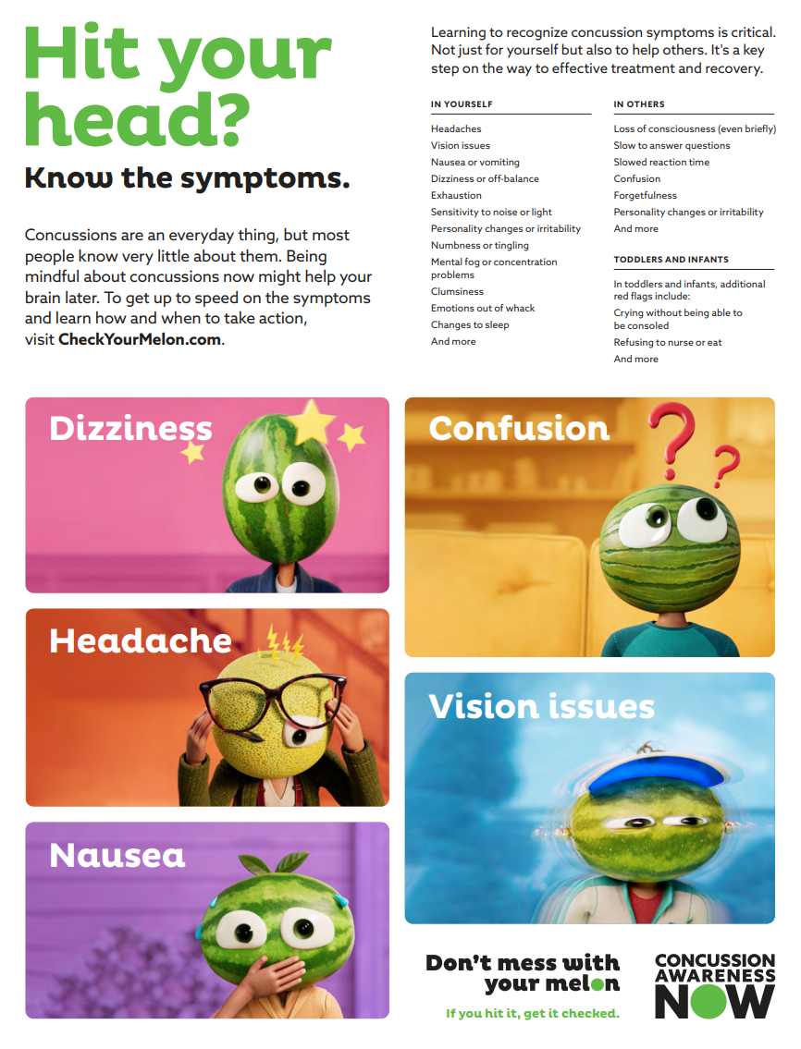
What are the symptoms of a concussion?
Concussions are different from person to person. Symptoms can develop immediately or over time.
Be aware of the symptoms so you can seek medical attention for yourself and loved ones!
Notes:
Symptoms of concussion:
Dizziness
Headache
Nausea
Confusion
Vision issues
It’s important to be aware of the symptoms for yourself, and so you can help others.

Slide 7
Did you know?
1 in 2 people who suspect a concussion do not get it checked.
The #1 reason for this is that people don’t believe symptoms are severe enough.
Notes:
Did you know –statistics.
Ask audience what they think about this statistic – does anything surprise them?

Slide 8
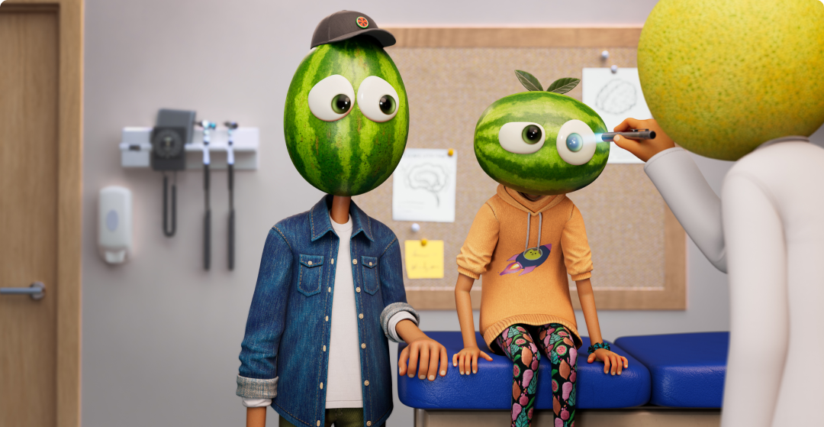
Seeking Medical Attention is
Important!
Stop, slow down, take a breath, and choose to prioritize your health. Take a moment to assess.
Look for symptoms – some may show up immediately. Other warning signs may not appear for hours or days after an injury. Know what to look for by reviewing the list of possible symptoms.
Get it checked. It’s important to be cautious. If you have even the slightest suspicion of a concussion, get help.
Notes:
Importance of Seeking Medical Attention
Know the steps – and when in doubt, seek medical care.

Slide 9
Test Your Concussion Knowledge!
Myth or Fact?
You’ll know you have a concussion, because you’ll notice the symptoms right away.

Slide 10
Test Your Concussion Knowledge!
Myth or Fact?
Every concussion is different, and symptoms can develop immediately, or over time. For some people, hours or even days may pass before they experience symptoms.

Slide 11
Test Your Concussion Knowledge!
Myth or Fact?
Sports related injuries are the leading cause of concussions.

Slide 12
Test Your Concussion Knowledge!
Myth or Fact?
The leading cause of concussions are falls during every day activities. Only 3% of concussions the present at the emergency room are sports-related.

Slide 13
Test Your Concussion Knowledge!
Myth or Fact?
You can suffer a concussion even if you don’t hit your head.

Slide 14
Test Your Concussion Knowledge!
Myth or Fact?
Concussions can result from a sudden jolt to the body or from any rapid movement in the head. You don’t have to hit your head to sustain a concussion.

Slide 15
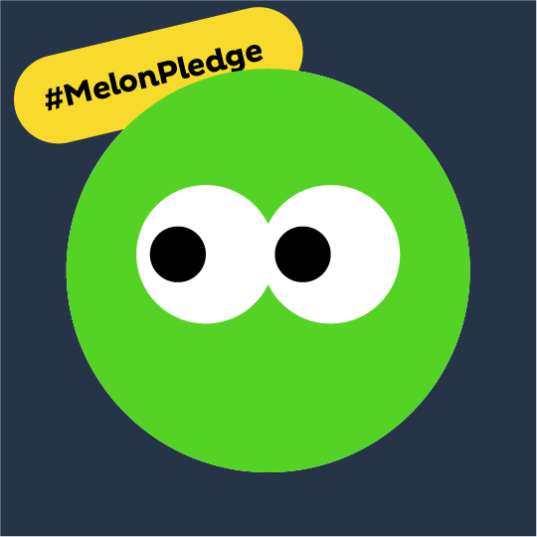
Take the Melon Pledge and Become a Concussion Awareness Champion!
Notes:
We want to create a future where every person with a concussion receives the right diagnosis, the best possible care, and the resources and information they need.
Commit to caring for yourself and others by not ignoring signs of a concussion and remember: Don’t mess with your melon. If you hit it, get it checked.
Share your commitment on social media to help spread the word and start the concussion conversation. Invite others to join you as a champion.

Slide 16
National Concussion Awareness Day: Start the Conversation Selfie Challenge
Get Involved!
Notes:
Another way to start the conversation is to participate in the selfie challenge. Think about how you might start the conversation after today’s presentation, in your own network of family/friends.
Download the document, customize it, snap a selfie and post on social media. Be sure to tag @ConcussionAwarenessNow!
Download at: Spread the word | Concussion Awareness Now

Slide 17
National Brain Injury Information Center
Resources
Have additional questions or need support?
Professionals at the National Brain Injury Information Center (NBIIC) are ready to answer your questions.
Dial 1-800-444-6443

Slide 18
Thank you for helping us Start the Concussion Conversation! #ConcussionConversation #NationalConcussionAwarenessDay #StartTheConversation #ConcussionAwarenessNow Visit concussionawarenessnow.org for more tools, resources and ways to get involved!

